Slide 1


Automatic License Plate Recognition
SUBMITTED TO:
SUBMITTED BY:
Prof. Jamvant S. Kumare
Prof. Amit Manjhwwar
RONAK UCHARIYA ( 0901CS181085 )
SAKSHI RAJPUT ( 0901CS181089 )

Slide 2
Automatic License Plate Recognition software
INTRODUCTION:
Automatic License Plate Recognition (ALPR)’ is the process of locating & extracting plate information from images or videos.
It is essential for several everyday applications automated payment services ( parking, toll roads payment collection, etc. )
The police and government agencies use ANPR as a tracking option to disrupt, prevent and detect criminal activity.

Slide 3

PARKING OPERATIONS
LAW ENFORCEMENT
01
03
SECURITY & SERVICES AUTOMATION
Monitoring vehicles
02
04
OBJECTIVES:

Slide 4




TECHNOLOGY & PLATFORM OVERVIEW
PYTHON
TensorFlow
CNN
OpenCV

Slide 5

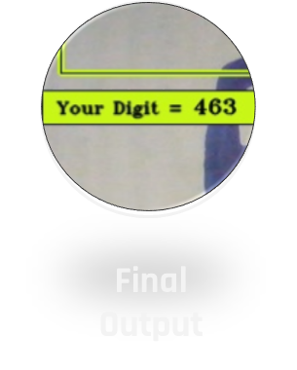
CNN Architecture
( Conv2D )
( Max pooling2D )
( Conv2D )
( Max pooling2D )
( Conv2D )
( Max pooling2D )
( Flatten )
( Softmax )
( Dense )
( Input )

Slide 6

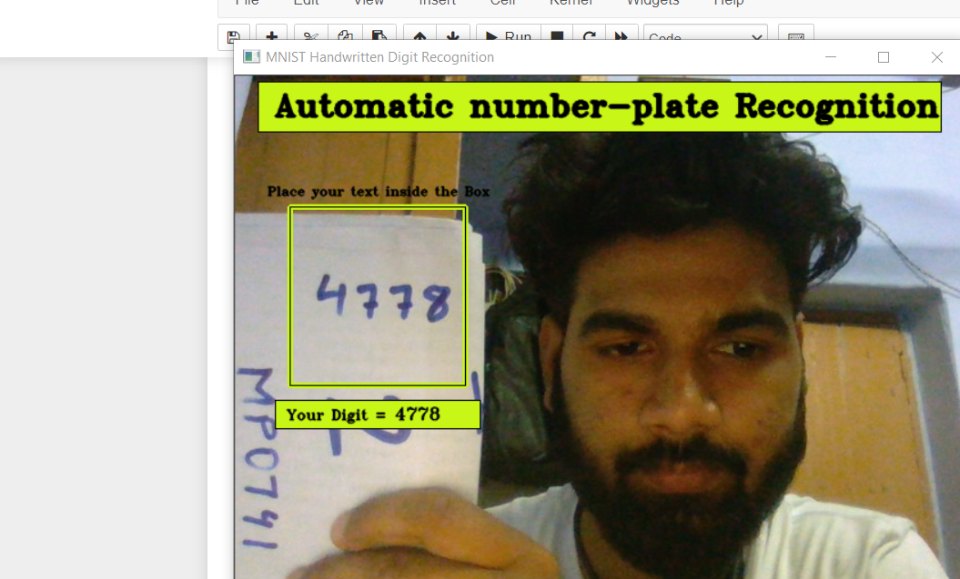
SOFTWARE SNAPSHOT
optical character recognition on images to read vehicle registration number plate

Slide 7
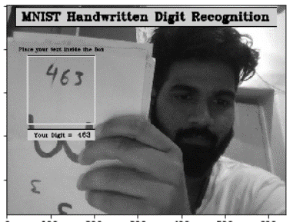
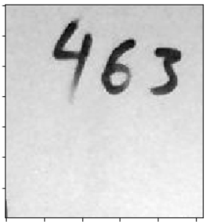
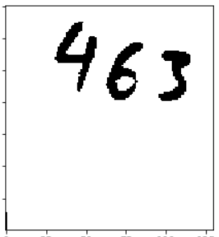
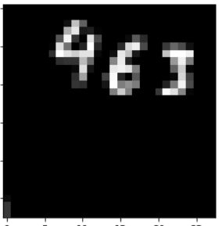
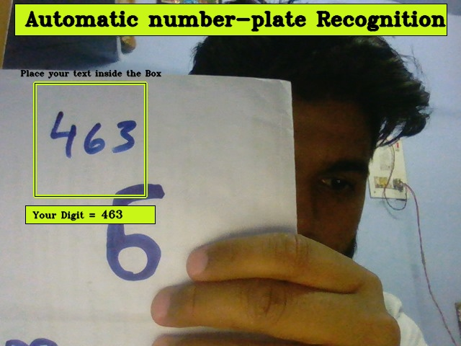
Image processing
1.
3.
Converting into Gray
Image Croping
Image Thresholding
Image Resizing
Final Output
2.
4.
5.

Slide 8
Source & Reference
https://www.youtube.com/channel/CodeWithHarry
https://www.youtube.com/channel/Machine Learning Hub
https://www.youtube.com/channel/Nicholas Renotte

Slide 9


PROJECT TEAM
SAKSHI RAJPUT
RONAK UCHARIYA
0901CS181089
0901CS181085

Slide 10





